Slide 1
Week 13

Slide 2
Updates - Quiz / Final Schedule
Quiz 5 - 11/18 - this THURSDAY
Quiz 6 - 12/2
Final - 12/7

Slide 3
Updates - Lab Schedule
Lab 09 - 11/15 - code - can submit late until Thursday, 11/18
Lab 10 - 11/22 - networking
Lab 11 - 12/3 (Friday before finals) - systems stuff / random
Lab redos - 12/10
07 - 11

Slide 4
Intro to Networking

Slide 5
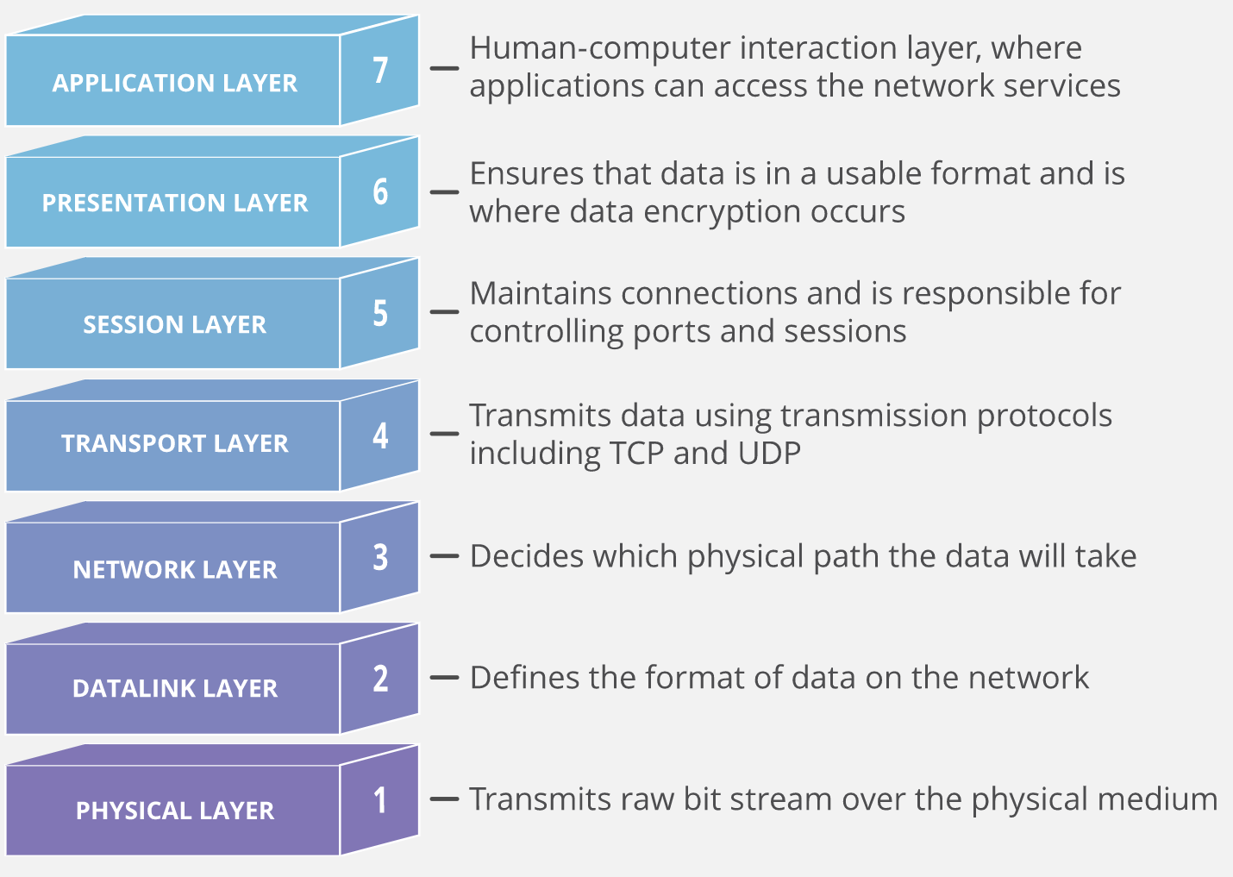

OSI Model
Notes:
https://www.cloudflare.com/learning/ddos/glossary/open-systems-interconnection-model-osi/

Slide 6
Essential Protocols of Networking
IP = Internet Protocol
Routes data packets from one machine to another
ICMP = Internet Control Message Protocol
Some support for IP such as error messages, routing assistance, debugging help
ARP = Address Resolution Protocol
Translates IP addresses to hardware addresses
UDP = User Datagram Protocol
Unverified, one-way delivery
TCP = Transmission Control Protocol
Reliable, full duplex, flow-controlled, error corrected conversations

Slide 7
Physical Layer
The medium data is transmitted on
Networking cables:
CAT 6 (copper)
Fiber (optical fiber)
Wifi
Radio signals
Table of MACs to IPs within a network (neighbors)
$ arp -n

Slide 8
Link Layer
MAC = Media Access Control
Addresses for use by hardware
One device can have multiple MACs - one per NIC (network interface card)
Each way to connect is uniquely identified by a MAC address
Wifi card has a MAC
Ethernet connect
IP addresses are assigned to network interfaces
MACs can be modified (or spoofed) but must exist uniquely on a network for traffic to know where it is going

Slide 9
Network Interface Cards
Usually have names that indicate the hardware underneath
Linux usually defines by connection type followed by number - ifconfig
eth0 = the first ethernet card in the computer
wlan0 = a wireless interface
lo = localhost = loopback
Windows usually defines by full name - ipconfig /all
Ethernet
Wi-Fi
Windows also has localhost
Virtual systems usually get labeled with virtual interface types
vEthernet
veth0

Slide 10









A Bit of Binary
2^0 = 1
2^1 = 2
2^2 = 4
2^3 = 8
2^4 = 16
2^5 = 32
2^6 = 64
2^7 = 128
Notes:
https://openbookproject.net/courses/intro2ict/networking/intro.html

Slide 11










Exercises
Assume 8 bits (one byte) to store the following numbers. Write the binary form given the base 10
3
8
27
133
Notes:
https://openbookproject.net/courses/intro2ict/networking/intro.html

Slide 12


IPv4 Addresses
Common form:
32 bit address separated into 4 bytes of 8 bits
You see: 172.16.0.1 (base 10)
But really: 10101100.00010000.00000000.00000001 (binary)
Every device on a network must have a unique IP address
4,294,967,296 unique IP addresses
NAT (Network Address Translation) helps us “break” this rule. We’ll get there soon
Notes:
https://openbookproject.net/courses/intro2ict/networking/intro.html

Slide 13

IPv6 Addresses
The “transition” process remains ongoing…
IPv6 was drafted in 1998 as devices needing network access boomed.
8 groups of 4 hexadecimal digits
2001:0db8:0000:0000:0000:8a2e:0370:7334
2001:db8::8a2e:370:7334
3.4 x 1038 unique IP addresses = 340 trillion trillion trillion
Dec: 0 1 2 3 4 5 6 7 8 9 10 11 12 13 14 15
Hex: 0 1 2 3 4 5 6 7 8 9 A B C D E F
Each hex digit reflects a 4-bit binary sequence.
Notes:
https://en.wikipedia.org/wiki/IPv6
https://www.redhat.com/sysadmin/what-you-need-know-about-ipv6
https://openbookproject.net/courses/intro2ict/networking/intro.html
https://www.bbc.co.uk/bitesize/guides/zp73wmn/revision/1

Slide 14
Starter Networking Commands
Linux:
$ ifconfig
$ ip a
Windows:
> ipconfig
> ipconfig /all
> Get-NetAdapter -Name * -IncludeHidden
“ifIndex” = interface index - helpful for upcoming routing table parsing
Notes:
https://goinbigdata.com/demystifying-ifconfig-and-network-interfaces-in-linux/

Slide 15
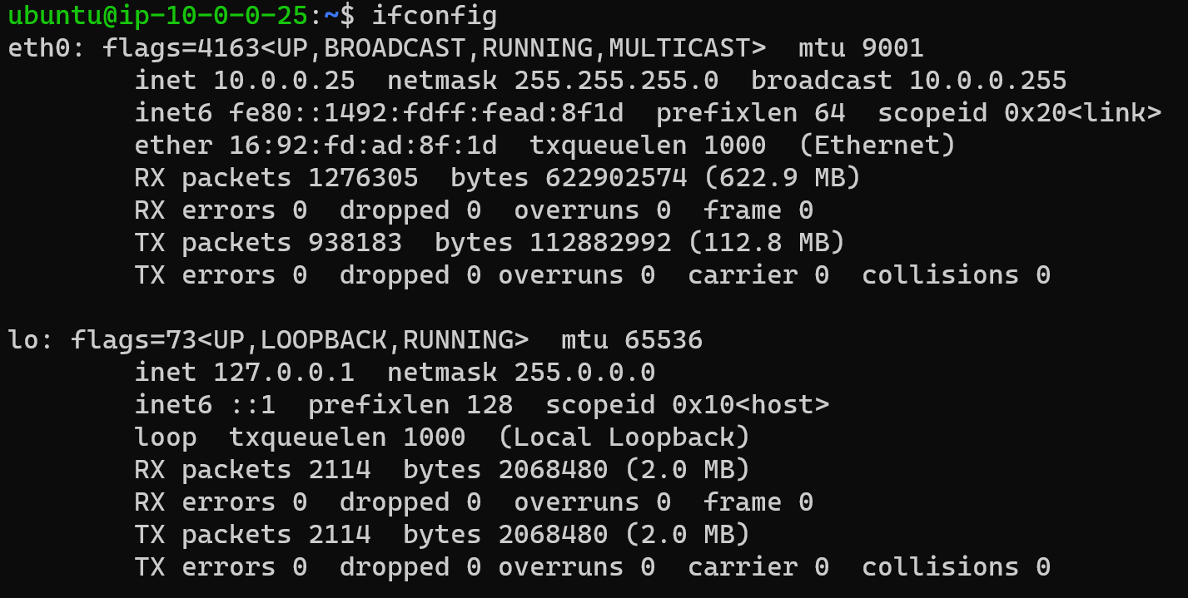
AWS ifconfig
Notes:
https://goinbigdata.com/demystifying-ifconfig-and-network-interfaces-in-linux/

Slide 16
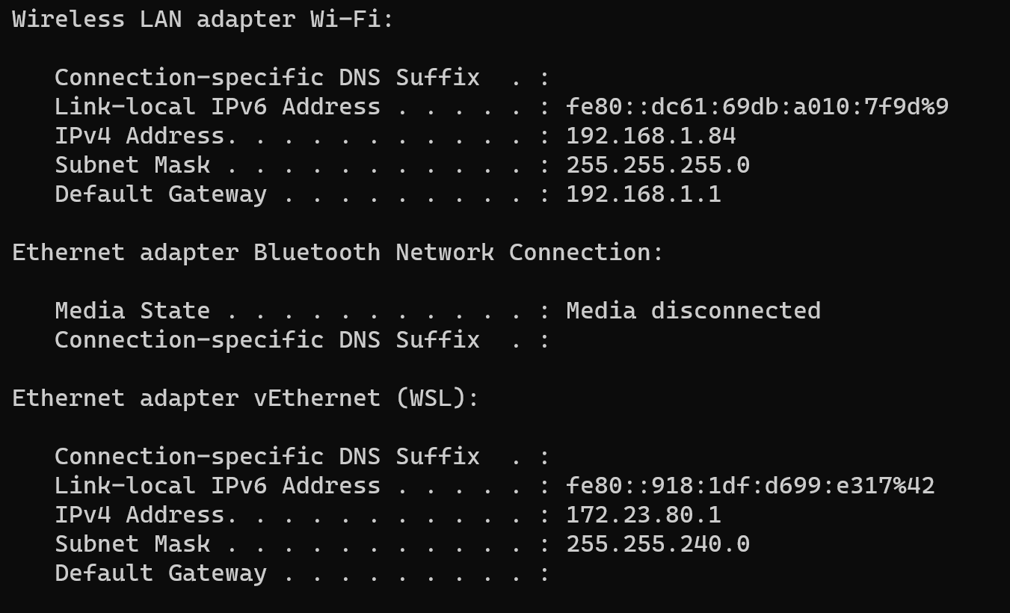
Windows ipconfig

Slide 17
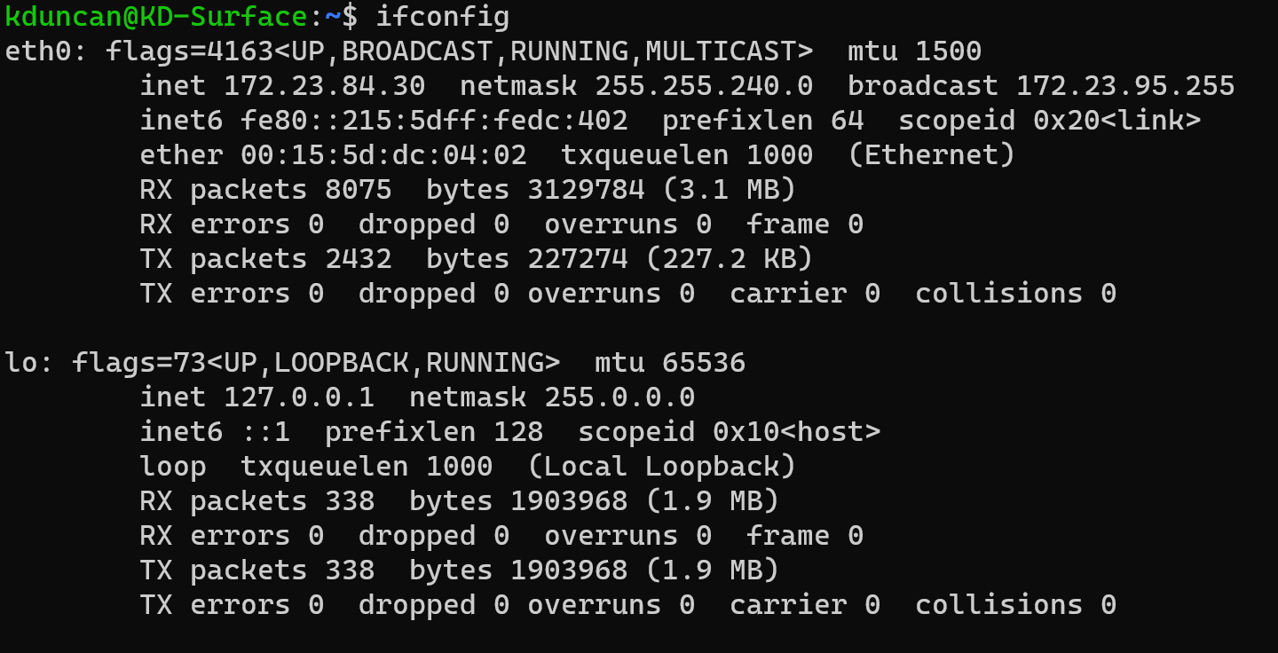
Local (WSL2) ifconfig
Notes:
https://goinbigdata.com/demystifying-ifconfig-and-network-interfaces-in-linux/

Slide 18
Hostname Resolution
I want to get the contents of xkcd.com
To make this request, I need a destination IP address for xkcd.com
How a hostname gets resolved
/etc/hosts
Local DNS cache
If I looked something up recently, I have a cache of the last known IP
/etc/resolv.conf - which nameservers to contact if “I” don’t know
ISP / company managed nameservers
If really lost:
Root domain server -> servers that know about .com names (Top Level Domains) -> domain registrar -> the name server with a record of the IP that corresponds to hostname xkcd.com
Notes:
$ nslookup hostname
$ nslookup IP
ipconfig /displaydns

Slide 19
Hostnames - system level
$ hostname OR > hostname - returns the hostname of the computer
Set in /etc/hostname
Can be set by the user, but must be a unique name on the network
Linux:
/etc/hostname
$ hostnamectl set-hostname [name]
$ systemctl restart systemd-hostnamed
Windows:
Via System Properties
> WMIC computersystem where caption='currentname' rename newname
Restart to take effect
Notes:
https://www.cyberciti.biz/faq/rhel-redhat-centos-7-change-hostname-command/
https://www.windows-commandline.com/change-computer-name-command-line/

Slide 20
Ports
16 bit number that supplements an IP address to specify a communication channel
Valid ports are in range 1 - 65,535
/etc/services - definition (not requirement) of standard services and their ports
Common ports to memorize:
80 - HTTP
443 - HTTPS
22 - SSH
Notes:
$ nmap hostname
$ nmap -Pn hostname port range

Slide 21





Ports Cont.
To prevent impersonation of system services, programs that want to bind to ports < 1024 must be run as root or be given the system level capability

Slide 22

Network Packets
When you send messages (or receive them) the messages are chunked into packets
Two general parts to a packet: header and data
Networks can restrict how big packets can be.
Usually you just go with the flow and hope the hardware along the way does the rest
Notes:
https://www.tutorialspoint.com/ipv4/ipv4_packet_structure.htm

Slide 23
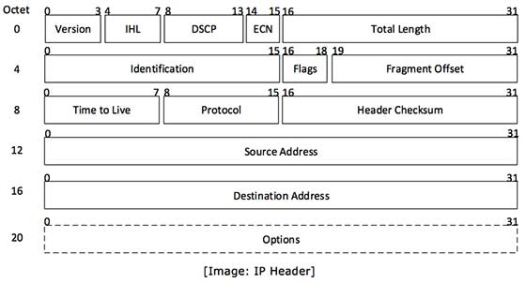
Packet Header (IPv4)
Version = IP version used (4 or 6)
IHL = length of header
Total length = size of datagram (header + payload)
Identification = which packet in a sequence
Flags + fragment offset = if packet needs broken down more
TTL = how many hops packet can make
Protocol = TCP / UDP / ICMP
Header checksum = checksum to check if packet is error free
Source address = sender of packet
Destination address = receiver of packet
Notes:
https://www.tutorialspoint.com/ipv4/ipv4_packet_structure.htm

Slide 24
Network Layer
How packets move from a source host to a destination
The internet is broken into many smaller networks - subnets
Traffic moves across subnets via routes
Transmitting data from one subnet to another is the job of a router
This is also referred to a as a gateway
Food for thought: When you order a package, is it sent straight to you?

Slide 25
Subnets
A connected group of hosts with IP addresses in a particular range
IP addresses consist of a network portion and a host portion
Network portion = logical network which the address refers to
Host portion = a node on that network
IPv4 addresses have at least 8 bits to specify the host portion & two bits to the host part
Netmask / subnet mask is a 32 bits specification of the network vs the host portion.
1s = network portion (and must be contiguous)
0s = host portion
/XX = CIDR Notation, where XX is the number of bits in the network portion
Notes:
http://www.steves-internet-guide.com/subnetting-subnet-masks-explained/

Slide 26









Subnet Cont.
Define a subnet with two pieces:
A network prefix + a subnet mask

Slide 27






Subnet Examples

Slide 28








AND Truth Table

Slide 29




Subnet examples

Slide 30


Subnet Examples

Slide 31





CIDR Notation
CIDR = Classless Inter Domain Routing
IP address / bit length of network prefix
There are some shortcuts to thinking about CIDR notation
Long Form | CIDR Form
255.0.0.0 | 8
255.255.0.0 | 16
255.240.0.0 | 12
255.255.255.0 | 24
255.255.255.192 | 26

Slide 32








Classless example (as in spans subnet classes)

Slide 33





CIDR Translation

Slide 34

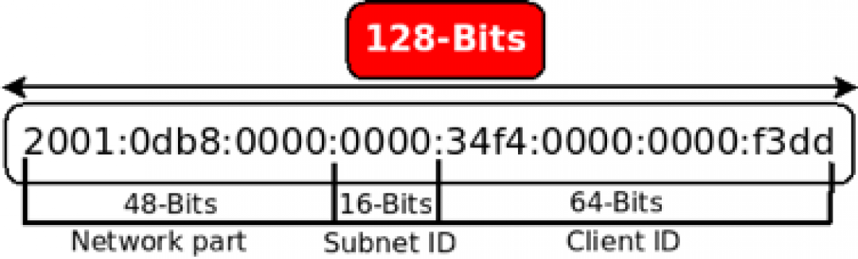
IPv6
The IPv6 address consists mainly of two 64-bit segments:
the higher part of the bits is classified as the network part
the lower 64 bits are classified as the client ID.
The network part is subdivided into the Global Unicast Address (GUA) and subnet ID. This information can be simplified by the following picture

Slide 35

Subnets are used to define:
Group of machines on a network that are connected
Group of machines on a network that are or are not allowed
Every address on internet: 0.0.0.0/0
A specific IPv4 Address: 129.21.67.34/32

Slide 36
Routes
Data is sent via a chain of subnets - at each “hop” the packet is told where to go next
“Routing”:
Looking up a network address in the routing table to forward a packet to its destination
Building the routing table
The route is chosen that has the longest matching destination prefix
Notes:
$ traceroute hostname
> tracert hostname

Slide 37
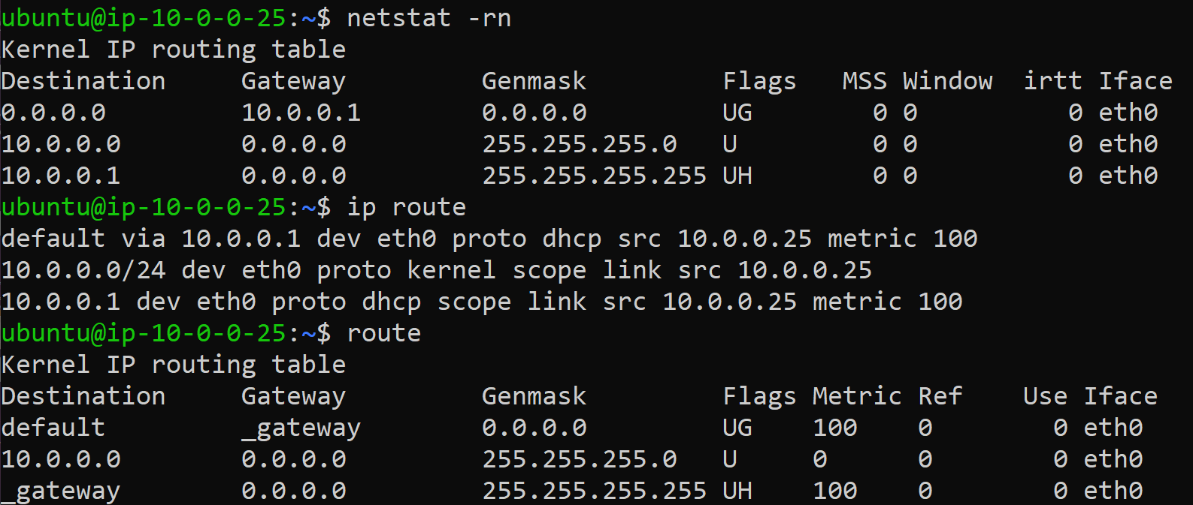
Routing Examples
Notes:
$ ip route
$ route
> route PRINT

Slide 38






Transport Layer
Data transmission characteristics - usually used when prepping for application layer
Data integrity checking
Source and destination ports
Specifications for breaking application data down into packets
Reassembling packets for application
Packets (data) can be broken and sent, sometimes out of order.
TCP & UDP are the most common protocols

Slide 39
IP Addresses for Private Use
Class | From | To | CIDR Range
A | 10.0.0.0 | 10.255.255.255 | 10.0.0.0/8
B | 172.16.0.0 | 172.31.0.0 | 172.16.0.0/12
C | 192.168.0.0 | 192.168.255.255 | 192.168.0.0/16
10 and 192.168 are the most common

Slide 40
NAT & border routers
NAT = Network Address Translation
PAT = Port Address Translation
The internet can’t use private IP addresses
NAT allows creation of a private subnet (many ips) that get “mapped” / translated to one public IP
This is how we survived the IPv4 shortage!
To allow private IP hosts to talk to the Internet, the border router uses NAT - intercepts packet, replaces source with valid external IP and (maybe) different source port number
Maintains table of mappings between internal / external address / port pairs to reverse / send back when packets arrive

Slide 41
Network Troubleshooting
Do you have physical connectivity and a link light?
Is your interface configured correctly?
Do your ARP tables show other hosts?
Is there a firewall on your local machine?
Is there a firewall anywhere between you and the destination?
If firewalls are involved, do they pass ICMP ping packets and responses?
Can you ping the localhost address (127.0.0.1)
Can you ping other local hosts (on your network) by IP address?
Is DNS working?
Can you ping other local hosts by hostname?
Can you ping hosts on another network?
Do high-level services such as web and SSH servers work?
Did you really check the firewalls?

Slide 42
DHCP - Dynamic Host Control Protocol
Wouldn’t it be sad if we had to manually do this?
Can allow clients to get Ips (randomly) OR can set a config based on system’s MAC and assign a consistent IP
Let’s a DHCP client lease (for a time frame):
IP addresses and netmasks
Gateways (default routers)
DNS nameservers
Syslog servers
TFTP servers
WINS servers, X font servers, proxy servers, NTP servers

Slide 43
Application Layer
The “language” that applications and servers use to communicate
Common protocols:
HTTP - Hypertext Transfer Protocol
TLS - Transport Layer Security - encryption protocols
HTTPS - HTTP + TLS
FTP - File Transfer Protocol

Slide 44
Network Security

Slide 45
VPN - Virtual Private Network
Org with many locations want to connect to one big private network
Secure & encrypted tunnel among locations
Client downloads VPN client
Implements VPN connectivity back to network
WSU VPN
Occasionally implements a “split tunnel” - looks to see if destination is to a WSU address - if yes, use VPN. Else use normal network

Slide 46
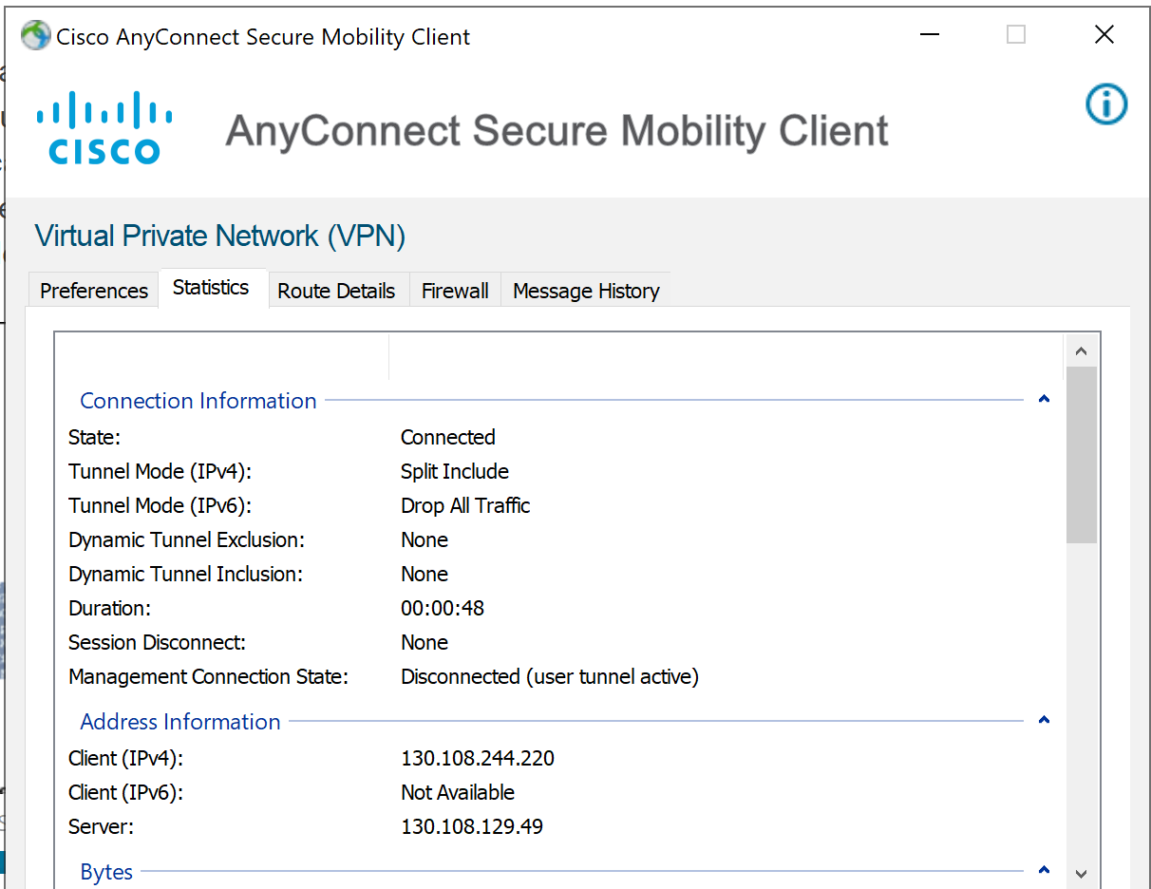

Slide 47
Network Firewalls
Apply to the network as a whole
Your home router can have firewalls configured
AWS - Security Groups

Slide 48
Types of packet filter firewalls
Stateless filters check basic information like port number, IP address, protocol, etc. of a packet to take action.
Stateful filters maintain records of connections passing through, can determine if a packet is the start of a new connection or a part of an existing connection. In iptables the four trackable states are NEW, ESTABLISHED, RELATED and INVALID.

Slide 49
Security groups
Manage rules for the overall network (VPC)
Inbound rules
Allowed subnet and for which ports that might be listening in the network
Must be set for internel and external requests
Outbound rules
What is allowed to go out from the network and where
Allow certain ports to certain sites.
Request to an update site (for example)
Outbound connections are allowed to get responses despite inbound rules
This would be a parallel to a network firewall appliance on a physical network

Slide 50
Firewall policies
Blacklist approach (default-allow)
All packets are allowed through except those that fit the defined blacklist.
Pros: flexible, less likely to impact services.
Cons: unexpected malicious traffic makes it through.
Whitelist approach (default-deny)
All packets are dropped or rejected unless specifically allowed.
Pros: safer network
Cons: unexpected important traffic gets dropped or rejected.
Notes:
https://github.com/mkijowski/ceg3400/tree/master/firewalls

Slide 51
Firewalls + packets
Firewalls take one of three actions on a packet.
Allow lets the packet pass through.
Drop prevents the packet from passing but is silent about it.
Reject prevents the packet from passing but notifies the sender that it is being blocked.
Action criteria:
Source / destination IP address or subnet
Source / destination port
Network interface

Slide 52
iptables
iptables specfically has multiple chains of rules that apply, here are the 5 predetermined ones:
PREROUTING are rules applied to all packets before any routing decisions are made.
INPUT are rules applied on packets that will be delivered locally.
FORWARD are rules applying to packets that have been routed but are not for locally delivery
OUTPUT are packets sent by the local machine.
POSTROUTING again are all packets but after they have been through all previous relevant chains.

Slide 53
# iptables -L
# iptables -P INPUT DROP
-P = policy
# iptables -flush

Slide 54
# iptables -L
# iptables -A INPUT -s 192.168.34.68 -j DROP
-A = appends a rule to the INPUT chain
-s = specifies source IP
-j = what to do with the matching rule (DROP)
# iptables -A INPUT -s 192.168.34.0/24 -p tcp --destination-port 25 -j DROP
# iptables -A INPUT -s 192.168.34.37 -j ACCEPT
# iptables -D INPUT 3
-D = delete a rule
# iptables -I INPUT -s 192.168.34.37 -j ACCEPT
-I = capital i = insert

Slide 55
Be careful creating rules
You can lock yourself out of SSH if you DROP all before allowing trusted SSH networks
But not to worry…
Iptables when set via the command line are like aliases - non-permanent until you set the configuration to auto load on boot
Exercise: create an SSH allow rule for trusted network(s)

Slide 56
More firewall resources
https://www.booleanworld.com/depth-guide-iptables-linux-firewall/
https://www.redhat.com/sysadmin/iptables
http://linux-training.be/networking/ch14.html
https://github.com/mkijowski/ceg3400/tree/master/firewalls

Slide 57
Fail2Ban vs PSAD
Fail2BAN scans log files of various applications such as apache, ssh or ftp and automatically bans IPs that show the malicious signs such as automated login attempts.
Think service level
PSAD on the other hand scans iptables and ip6tables log messages (typically /var/log/messages) to detect and optionally block scans and other types of suspect traffic such as DDoS or OS fingerprinting attempts. It's ok to use both programs at the same time because they operate on different level.
Think ip level

